Slide 1


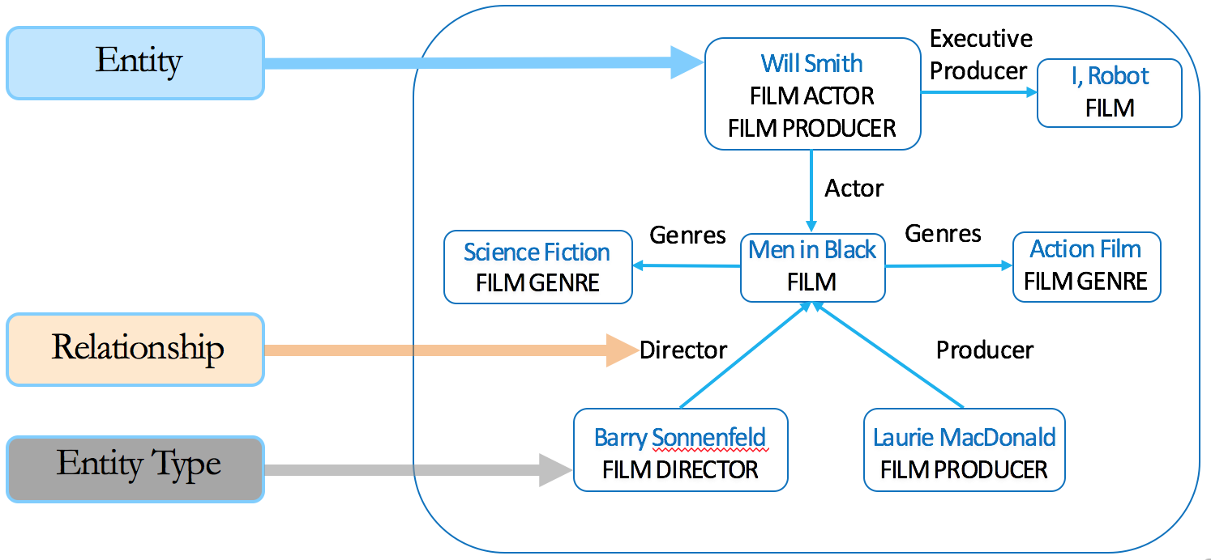
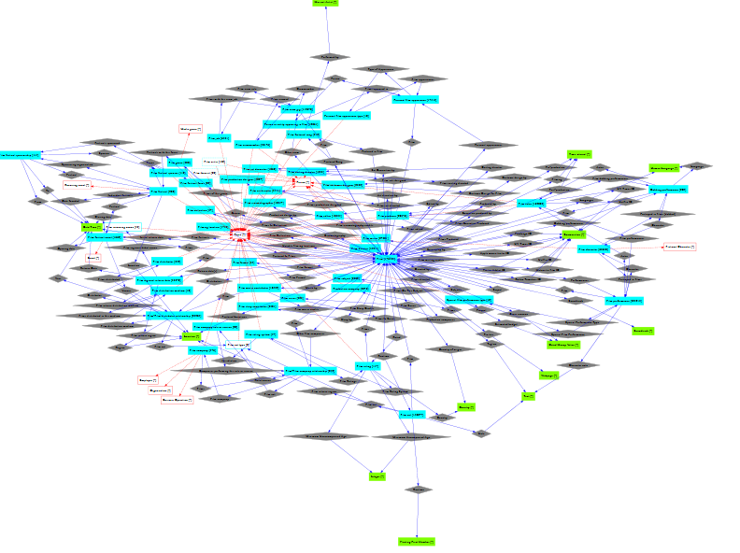
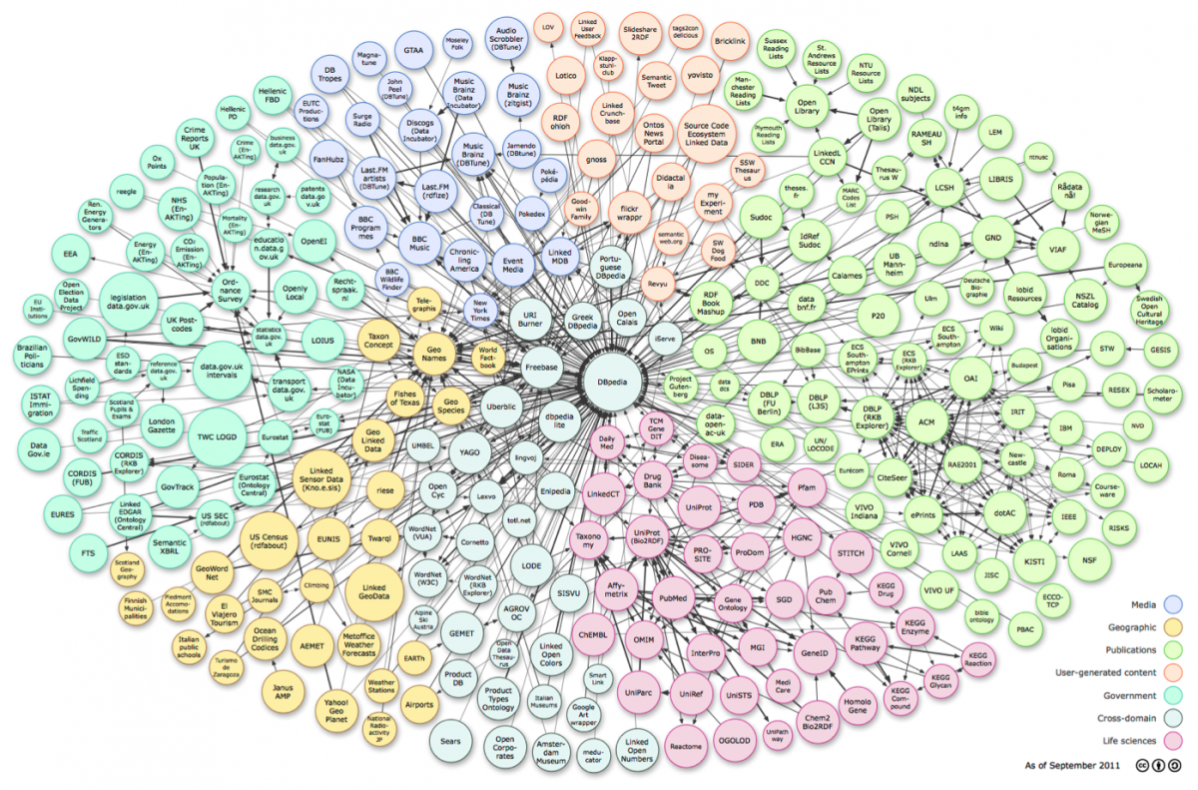
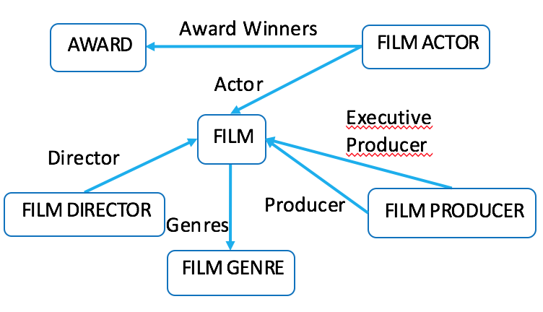
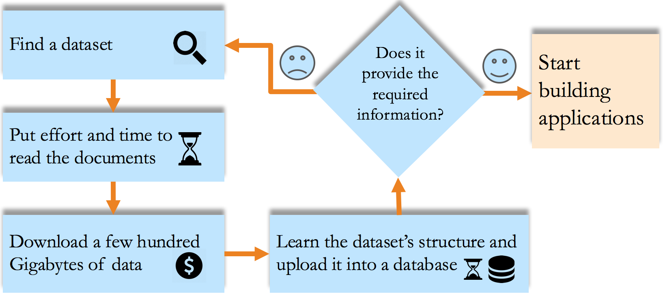
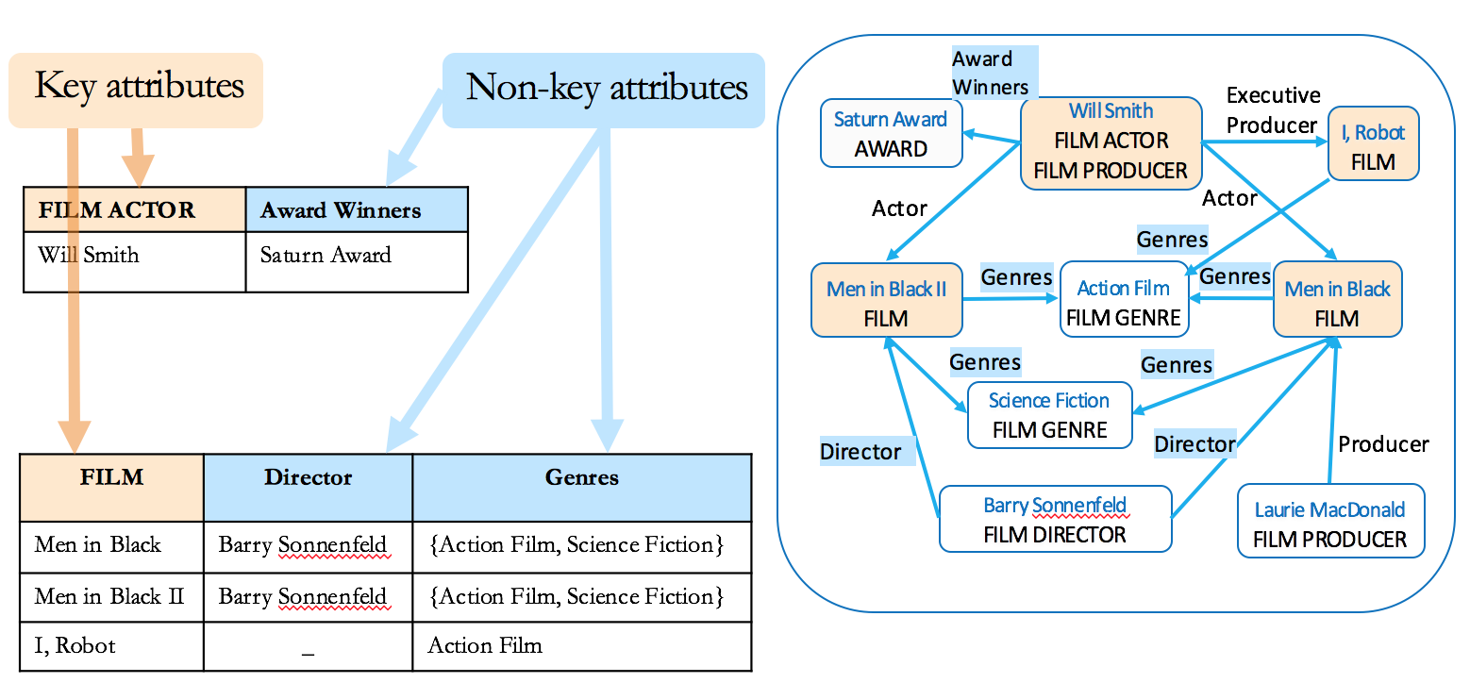
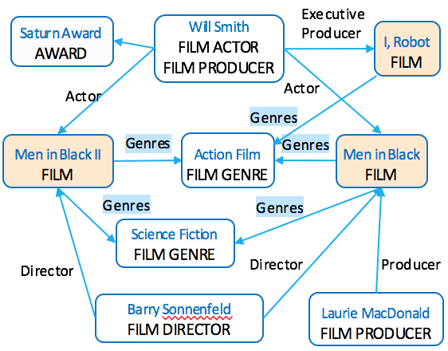
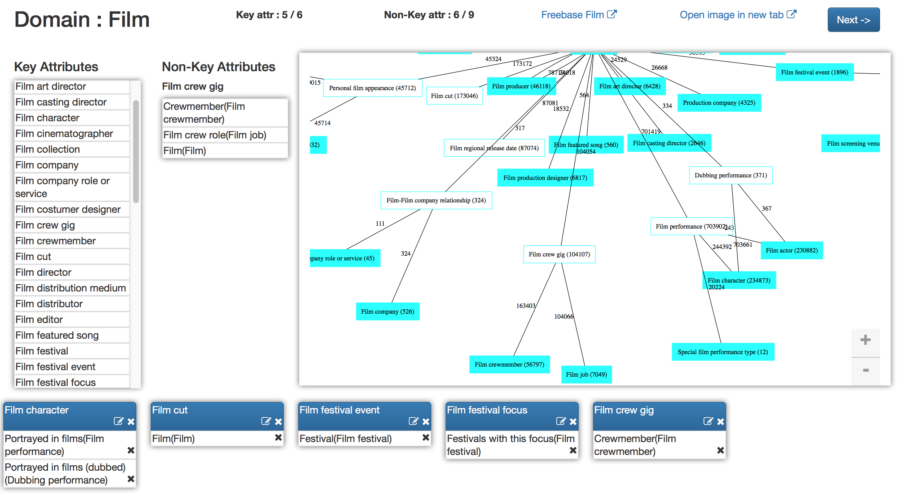
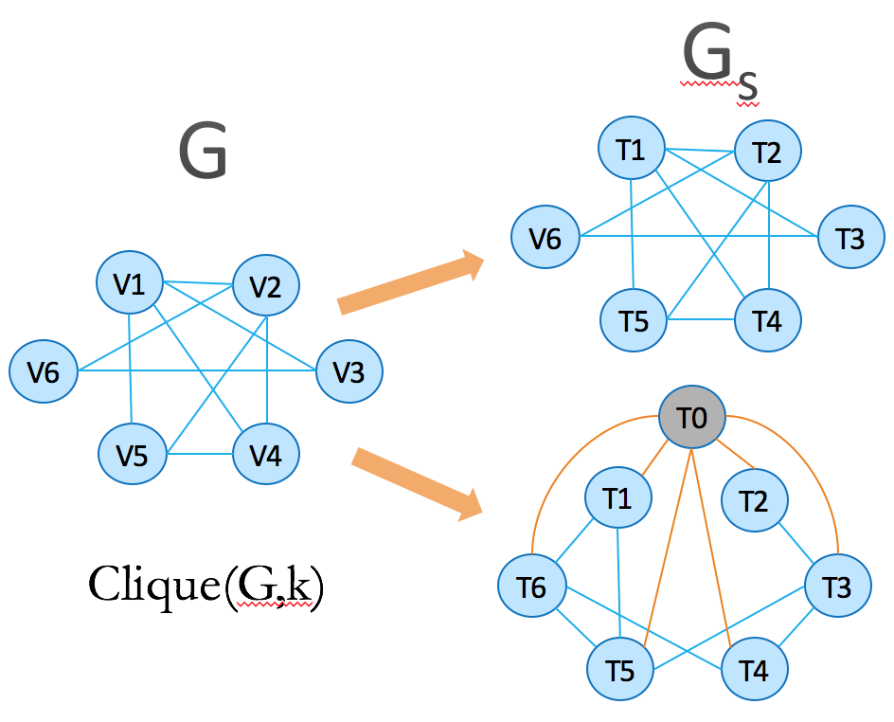
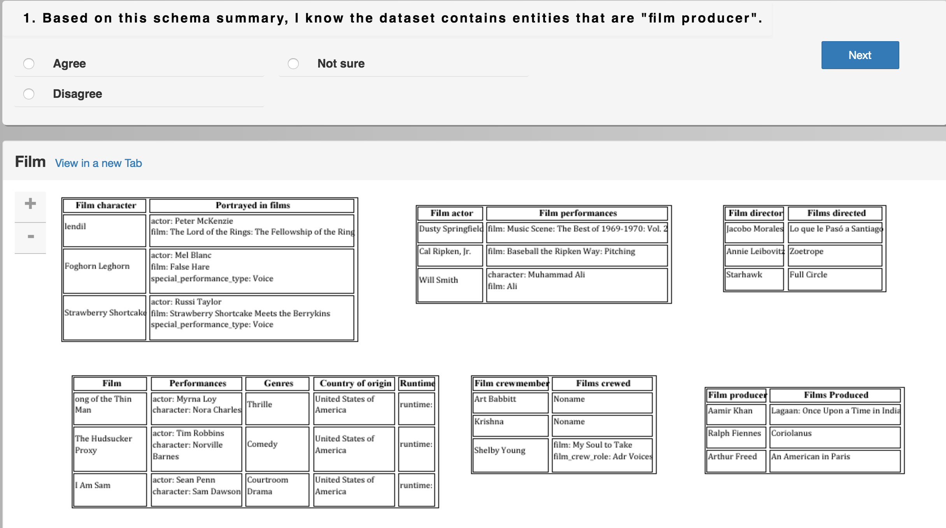

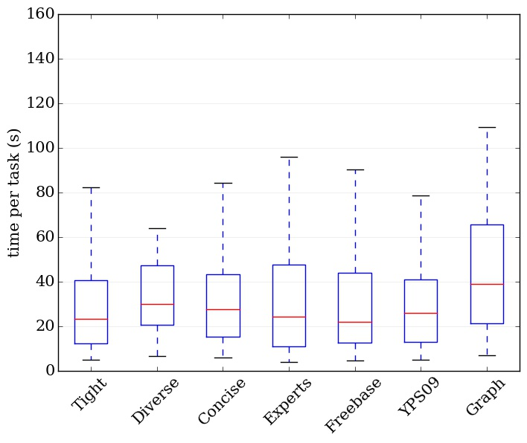



Generating Preview Tables for Entity Graphs
Ning Yan^{1#} , Sona Hasani*, Abolfazl Asudeh *, Chengkai Li *
Huawei U.S. R&D Center# University of Texas at Arlington*
¹The work was done while at UTA. Innovative Database and Information Systems Research (IDIR) Laboratory Innovative Database and Information Systems Research (IDIR) Laboratory
Ultra-heterogeneous Entity Graphs
Entity Graph
Need for a Quick Overview
Large and complex graphs capturing millions of entities and billions of relationships between entities.
Approach 1: Schema Graph
Schema Graph itself can be too complex.
Freebase : 1.9 billion triples
DBpedia : 3 billion triples
YAGO : 120 million triples
Linked Open Data : 52 billion triples
Steep Flag-Down Cost
Approach 2: Schema Summary
Schema summarization in relational database [Yang PVLDB09, Yang PVLDB11]
XML summarization [Yu VLDB06]
Graph summarization [Tian SIGMOD08, Zhang ICDE10]
Schema graph of “Film” domain in Freebase Entity graph: 2M entities, 18 M edges Schema graph: 63 entity types ,136 edges
http://linkeddata.org/
Applications: search, recommendation systems, business intelligence, health informatics, fact checking
Preview Tables
Too Many Previews. Which One to Choose?
Attribute Scoring
FILM | FILM SET DECORATOR | FILM EDITOR
FILM | FILM DIRECTOR | FILM PRODUCER
Key attribute scoring
PRODUCTION COMPANY | FILM
A
FILM WRITER | FILM
B
Coverage-based method: Coverage(FILM) = 3 Random walk-based method : Stationary distribution of a random walk process defined over the schema graph
Aggregate Scoring
FILM | Actor | Genres
4 | 6 | 5
Score of the Preview
Non-key attribute scoring
FILM ACTOR | Actor | Award Winners
2 | 6 | 2
4 × (6+5) = 44
+
60
Coverage-based method : Coverage(Genres) = 5
Entropy-based method : Entropy(Genres) = (2/3) log(3/2)+(1/3) log(3/1) = 0.28
FILM | Director | Genres
Men in Black | Barry Sonnenfeld | {Action Film, Science Fiction}
Men in Black II | Barry Sonnenfeld | {Action Film, Science Fiction}
I, Robot | _ | {Action Film}
2 × (6+2) = 16
Optimal Preview Discovery
Algorithms
User Study
Find the preview with highest score that satisfies
Size constraint
Number of key attributes K
Number of non-key attributes N
Distance between two preview tables d
Concise preview, dynamic programming algorithm
Domains:
film, books, music, TV, people
dist(Ti, Tj) ≤ d
We assume all K key attributes are ordered arbitrarily.
optimal concise preview (k, n, X) is the best of:
optimal concise preview (k, n, X-1)
optimal concise preview (k-1, n-1, X-1) ∪ X-th Key-attribute with 1 non-key attribute
optimal concise preview (k-1, n-2, X-1) ∪ X-th Key-attribute with 2 non-key attributes
… …
optimal concise preview (k-1, k-1, X-1) ∪ X-th Key-attribute with (n-k+1) non-key attributes
Hand-crafted preview tables
10 PhD students in Database research group
Individually and as a group
$20 gift card
Concise
Tight Diverse
FILM | Performances | Genres | Directed By
dist(Ti, Tj) ≥ d
Tight/Diverse preview, Apriori property algorithm
Existence/experience questions
Schema graph
Concise preview
Tight preview
Diverse preview
Freebase ground truth
YPS09
Hand-crafted preview tables
84 Master’s and PhD students in database area
$15 gift card
FILM DIRECTOR | Films Directed
1. Construct 2-cliques by enumerating all key attribute pairs
2. for i = 3 to k
generate i-cliques from (i-1)-cliques based on Apriori property
3. find the k-clique with highest score, return as optimal preview
NP-hard
FILM PRODUCER | Films Produced
Tight
Tight (Gs, k, k, 1, 0)
FILM FESTIVAL | Location | Focus
FILM COMPANY | Films
FILM CHARACTER | Portrayed in Film
Diverse
Diverse(Gs, k, k, 2, 0)
Experiment Results
 | Tight | Diverse | Freebase | Experts | YPS09 | Schema Graph
Concise | z=1.59 p=0.0559 | z=−2.28 p=0.0113 | z=0.49 p=0.3121 | z=−0.13 p=0.4483 | z=0.36 p=0.3594 | z=−0.43 p=0.3336
Tight |  | z=−3.48 p=0.0003 | z=−1.12 p=0.1314 | z=−1.69 p=0.0455 | z=−1.282 p=0.0999 | z=−1.93 p=0.0268
Diverse |  |  | z=2.57 p=0.0051 | z=2.10 p=0.0179 | z=2.60 p=0.0047 | z=1.70 p=0.0446
Freebase |  |  |  | z=−0.61 p=0.2709 | z=−0.15 p=0.4404 | z=−0.87 p=0.1922
Experts |  |  |  |  | z=0.49 p=0.3121 | z=−0.29 p=0.3859
YPS09 |  |  |  |  |  | z=−0.77 p=0.2206
Time taken on existence tests, domain=“music”
Pairwise comparisons of conversion rates, domain=“music”, α=0.1
Key attribute scoring (precision-at-k)
Questions | most favorable Least favorable
How easy was it to read the schema summary? | Freebase | Diverse | Graph | Experts | YPS09 | Concise | Tight
How much understanding of the data can you gain from it? | Graph | Freebase | YPS09 | Diverse | Concise | Tight | Experts
How helpful was it in assisting you to understand the data? | Graph | Freebase | YPS09 | Diverse | Experts | Concise | Tight
Is it missing important information? | YPS09 | Concise | Experts | Graph | Tight | Freebase | Diverse
 | Key Attribute |  |  | Non-key Attribute
Domain | YPS09 | Coverage | Random Walk | Coverage | Entropy
books | 0.4 | 0.55 | 0.43 | 0.43 | 0.43
film | -0.01 | 0.48 | 0.25 | 0.35 | 0.35
music | 0.37 | 0.33 | 0.46 | 0.42 | 0.41
TV | 0.37 | 0.69 | 0.65 | 0.47 | 0.47
people | 0.36 | 0.31 | 0.29 | 0.43 | 0.43
Domain | Coverage | Entropy
books | 0.8 | 0.786
film | 0.2 | 0.25
music | 0.528 | 0.589
TV | 0.622 | 0.379
people | 0.708 | 0.606
Comparison between rankings by our approach and the crowd , Pearson Correlation Coefficient (PCC)
Mean Reciprocal Rank (MRR) of Non-key attributes
Systems sorted by average user experience scores across five domains

